Slide 1


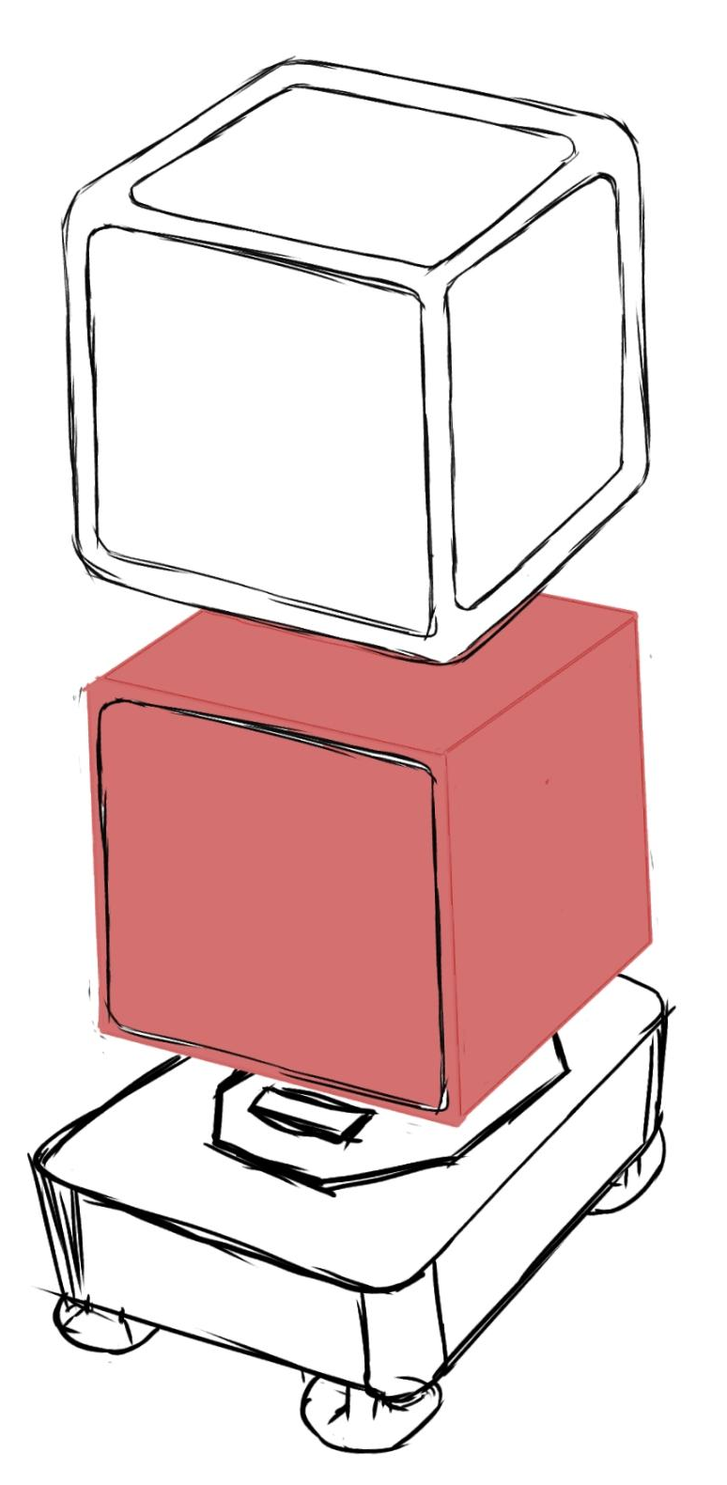
Pix Bot
PHYSICAL & VIRTUAL
REPRESENTATION
Physical representation is made to depict the conceptual model to understand Ergonomic and Antropometrics of the product. The virtual representation helps in presenting Voice of Customerto some extent
Product Modeling & Virtual Reality
MNFG608
Swaraj Patra
Video Link-
https://youtu.be/z5iqq7t2qpA

Slide 2
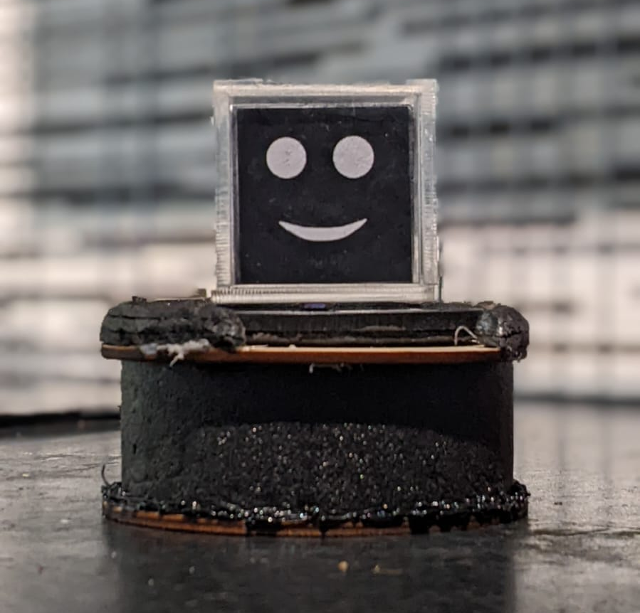
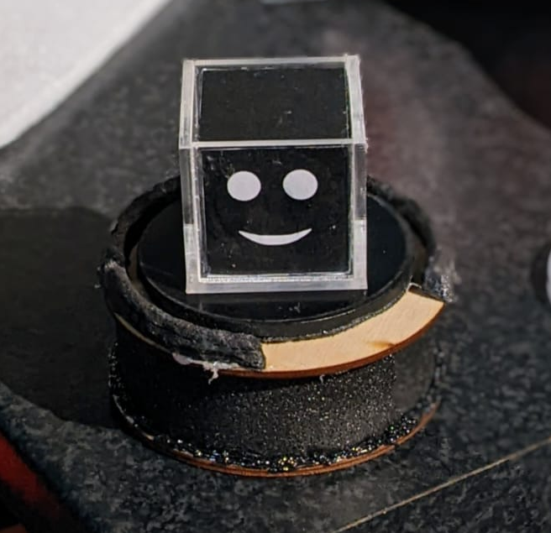
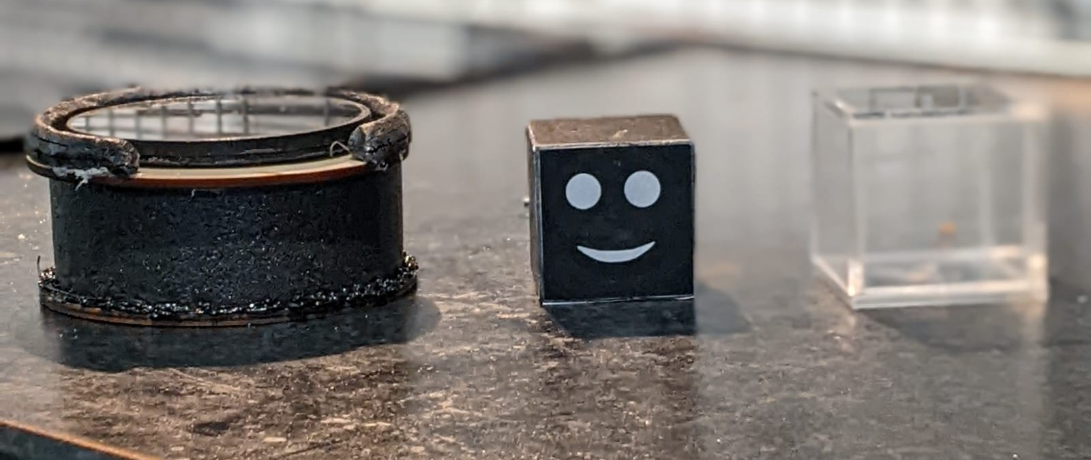
PHYSICAL REPRESENTATION
Model made of foam, Acrylic and Wood. Magnets are used to hold charger and cube together. Top of charging unit rotates and bottom of cube is closed using magnets so different interfaces and expressions could be tested in the cube.
Ergonomics & Anthropometrics
The physical model greatly helped in understanding the ergonomic and anthropometrics of the conceptual product. The original conceptual size was to be 7 cm cube but during prototyping 5cm cubes felt to be more appropriate. The cut Acrylic is smoothened but it was also realized a casings of soft and shock absorbing material can be used to make it more safe and durable. Use of magnets to hold cube to the charger would make sure it is firm while charging and along with suction caps on bottom of charger it can even be placed on walls.

Slide 3
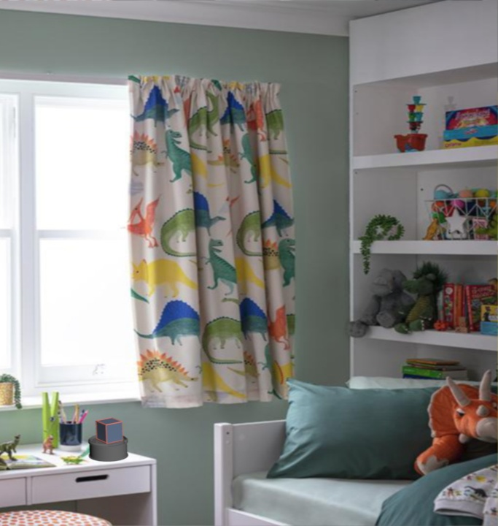
VIRTUAL REPRESENTATION
The virtual representation for outer appearance of the product is made along with its Charging pad and some other modules that can be used with the Pix. The virtual presentation of cube includes main body, charging connections, magnetic joints and connection holes for connecting with modules.
Voice of Customer
Modularity- Variety of modules can be used to make PIX more versatile. These modules could encourage kids to develop new hobbies, learn new skills or make learning more fun.
Gender neutrality- Since the main PIX body has a simple yet intriguing design the neutrality could be maintained by bringing variations in color schemes and mods.
Age compatibility- Pix is designed so it could be an aid during the growing years of kids to maintain this Pix is made super versatile so it can teach children a variety of things. The data is updateable to keep the lerning experience fresh.
Built- Pix is made robust so it can handle day to day impact as other toys that kids play with. Yet the interactive display is highlighted by expressions produced which sync with audio output.

Slide 4
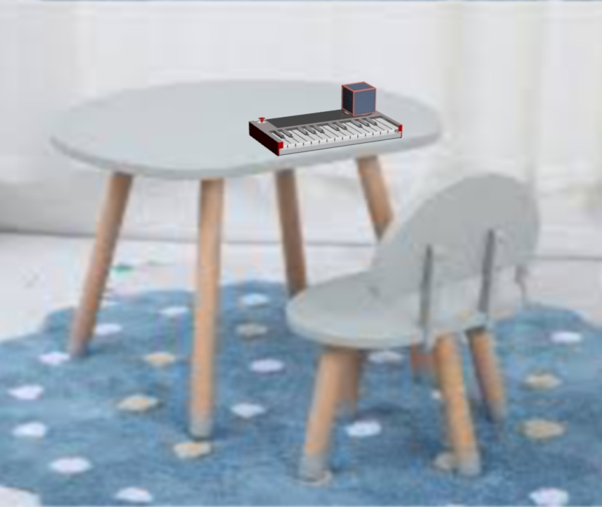
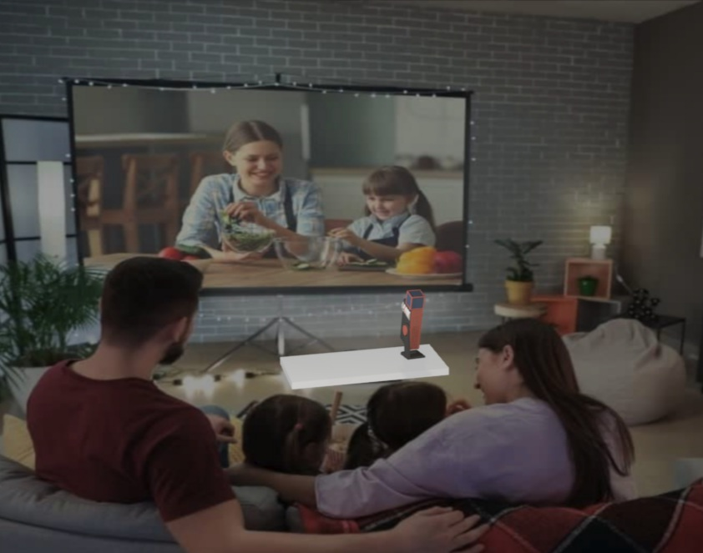
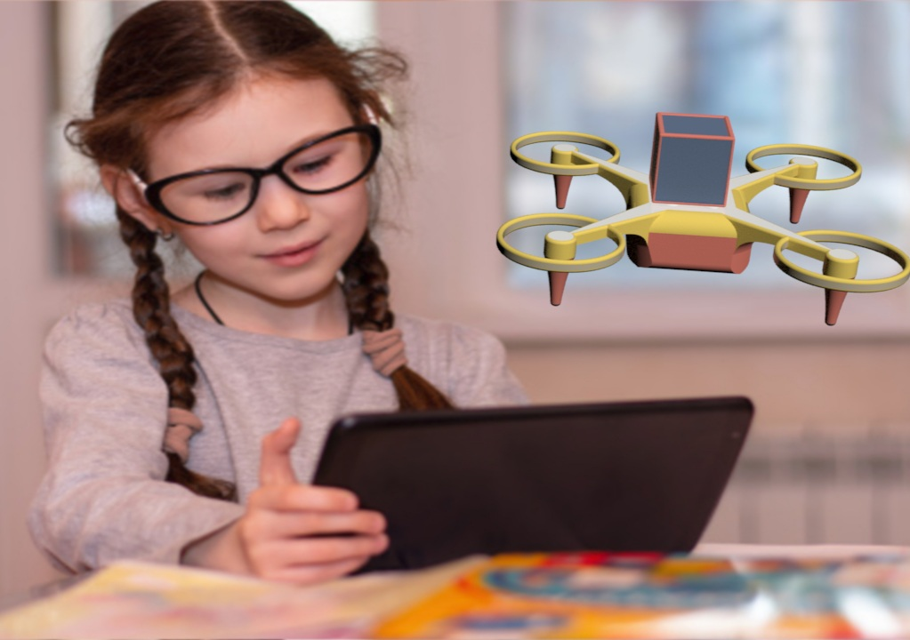
VIDEO LINK : https://youtu.be/z5iqq7t2qpA

